Slide 1

Database Performance Tuning
Presented By:
Elizer Ponio Jr. Department of Computer Science
College of Computing and Information Technologies

Slide 2

Application Performance
One of the aspects of application design is the performance one expects out of the application.
it is common to find that once an application has been built, it runs slower than the designers wanted or handles fewer transactions per second than they required.
An application that takes an excessive amount of time to perform requested actions can cause user dissatisfaction at best and be completely unusable at worst.

Slide 3
Performance Tuning
Applications can be made to run significantly faster by performance tuning.
Performance tuning consists of finding and eliminating bottlenecks and adding appropriate hardware such as memory or disks.
There are many things an application developer can do to tune an application, and there are things that a database-system administrator can do to speed up processing for an application.

Slide 4
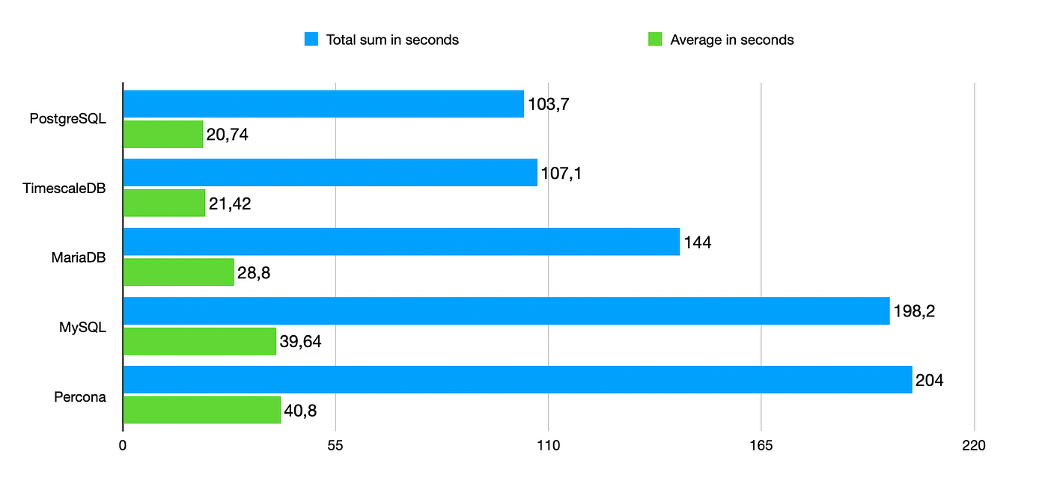
Benchmarks
Benchmarks are standardized sets of tasks that help to characterize the performance of database systems.
They are useful to get a rough idea of the hardware and software requirements of an application, even before the application is built.
There are two primary types of benchmark: synthetic and real-world benchmarks.

Slide 5
Benchmarks
Synthetic benchmarks usually simulate real-world workloads by attempting to follow the same patterns to determine how the existing database configuration and hardware work together under a given type of workload. It can run anywhere, independent of schema design. However, synthetic benchmarks cannot replace real-world conditions.
Real-world benchmarks use a data set and queries related to the application. It does not necessarily require a full database benchmark dataset and complete query mix. The idea is to see and understand the precise interactions between the application, database configuration, and hardware, either some particular aspect or in general.

Slide 6
Reasons for Performance Tuning
Applications sometimes exhibit poor performance, with queries taking a long time to complete, leading to users being unable to carry out tasks that they need to do.
We describe a few real-world examples that we have seen, including their causes and how tuning fixed the problems

Slide 7
Real world scenarios for Tuning
In the first application, we found that users were experiencing long delays and time-outs in the web applications.
Causes:
On monitoring the database, we found that the CPU usage was very high, with negligible disk and network usage.
Further analysis of queries running on the database showed that a simple lookup query on a large relation was using a full relation scan, which was quite expensive.
Solution:
Adding an index to the attribute used in the lookup drastically reduced the execution time of the query and a key performance problem vanished immediately

Slide 8
Real world scenarios for Tuning
In a second application, we found that a query had very poor performance.
Causes:
Examining the query, we found that the programmer had written an unnecessarily complicated query, with several nested subqueries, and the optimizer produced a bad plan for the query, as we realized after observing the query plan.
Solution:
To fix the problem, we rewrote the query using joins instead of nested subqueries, that is, we decorrelated the query. This change greatly reduced the execution time.

Slide 9
Real world scenarios for Tuning
In a third application, there is an unoptimized query that takes too long to finish
Causes:
We found that the application fetched a large number of rows from a query, and issued another database query for each row that it fetched.
This resulted in a large number of separate queries being sent to the database, resulting in poor performance.
Solution:
It is possible to replace such a large number of queries with a single query that fetches all required data. Such a change improved the performance of the application by an order of magnitude.

Slide 10
Real world scenarios for Tuning
In a fourth application, it stopped working when it was deployed for actual use.
Causes:
We found that while the application performed fine under light load during testing, it completely stopped working when subjected to heavy load when it was used by actual users.
In this case, we found that in some of the interfaces, programmers had forgotten to close JDBC connections. Databases typically support only a limited number of JDBC connections, and once that limit was reached, the application was unable to connect to the database, and thus it stopped working.
Solution:
Ensuring that connections were closed fixed this problem.

Slide 11

Real world scenarios for Tuning
It is also worth pointing out that in several cases above the performance problems did not show up during testing.
Either because the test database was much smaller than the actual database size or because the testing was done with a much lighter load (number of concurrent users) than the load on the live system.
It is important that performance testing be done on realistic database sizes, with realistic load, so problems show up during testing, rather than on a live system.

Slide 12

Bottlenecks
The performance of most systems (at least before they are tuned) is usually limited primarily by the performance of one or a few components, called bottlenecks

Slide 13
Bottlenecks
For example, a program may spend 80 percent of its time in a small loop deep in the code, and the remaining 20 percent of the time on the rest of the code. the small loop then is a bottleneck.
Improving the performance of a component that is not a bottleneck does little to improve the overall speed of the system.
In the example, improving the speed of the rest of the code cannot lead to more than a 20 percent improvement overall whereas improving the speed of the bottleneck loop could result in an improvement of nearly 80 percent overall, in the best case.

Slide 14
Bottlenecks
When tuning a system, we must first try to discover what the bottlenecks are and then eliminate them by improving the performance of system components causing the bottlenecks.
When one bottleneck is removed, it may turn out that another component becomes the bottleneck.
In a well-balanced system, no single component is the bottleneck.

Slide 15
Bottlenecks
For simple programs, the time spent in each region of the code determines the overall execution time.
For database systems are much more complex, and query execution involves not only CPU time, but also disk I/O and network communication.
A first step in diagnosing problems to use monitoring tools provided by operating systems to find the usage level of the CPU, disks, and network links.
Most databases provide ways to find out which queries are taking up the maximum resources, such as CPU, disk I/O, or network capacity.

Slide 16
Bottlenecks
To understand the performance of database systems better, it is very useful to model database systems as queueing systems.
A transaction requests various services from the database system.
Each of these services has a queue associated with it, and small transactions may spend most of their time waiting in queues.
Bottlenecks in a database system typically show up in the form of long queues for a particular service, or, equivalently, in high utilizations for a particular service.

Slide 17
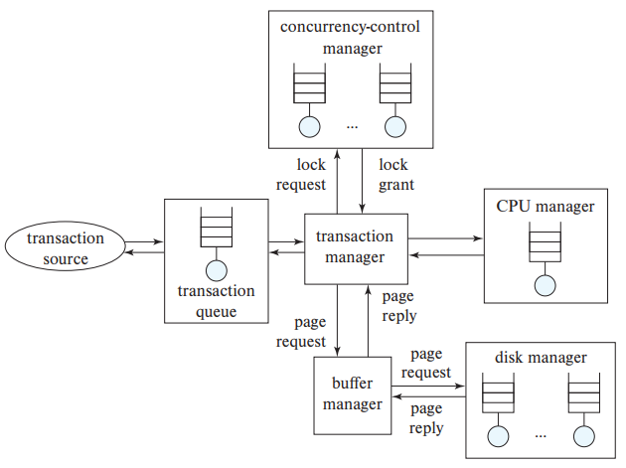
The transaction queue is used by the database system to control the admission of new queries when the number of requests exceeds the number of concurrent query execution tasks that the database allows.

Slide 18
Utilization
If a resource, such as a disk, has a low utilization, then when a request is made, the resource is likely to be idle, in which case the waiting time for the request will be 0.
If a resource has a high utilization or 100 percent utilization, the queue length increases sharply, resulting in excessively long waiting times.
The utilization of a resource should be kept low enough that queue length is short.
As a rule of the thumb, utilizations of around 70 percent are considered to be good, and utilizations above 90 percent are considered excessive, since they will result in significant delays.

Slide 19


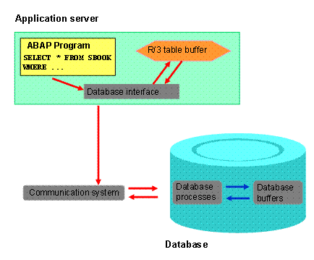
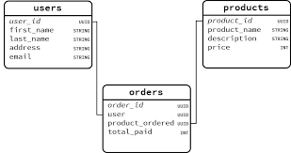


Tuning Levels
Database administrators and application developers can tune a database system at three levels
Tuning schemas and queries.
Tuning database parameters such as buffer size.
Tuning hardware components.

Slide 20
Tuning Schemas and Queries
The highest level of database tuning, which is under the control of application developers, includes the schema and queries.
The developer can tune the design of the schema, the indices that are created, and the transactions that are executed to improve performance.
Tuning at this level is comparatively system independent.

Slide 21
Tuning Schemas
Tuning of the physical schema, such as indices and materialized views, is the least disruptive mode of tuning, since it does not affect application code in any way
We can tune the indices in a database system to improve performance.
When created indexes:
If queries are the bottleneck, we can often speed them up by creating appropriate indices on relations.
If updates are the bottleneck, there may be too many indices, which have to be updated when the relations are updated. Removing indices may speed up certain updates.

Slide 22
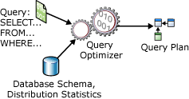
Tuning Queries
The performance of an application can often be significantly improved by rewriting queries.
In the past, optimizers on many database systems were not particularly good, so how a query was written would have a big influence on how it was executed, and therefore on the performance.
Today’s advanced optimizers can transform even badly written queries and execute them efficiently, so the need for tuning individual queries is less important than it used to be.
However, sometimes query optimizers choose bad plans

Slide 23
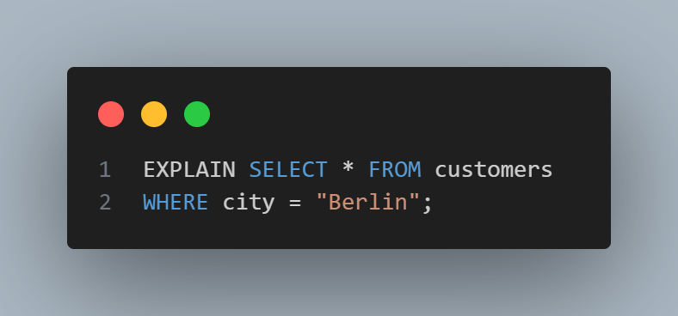
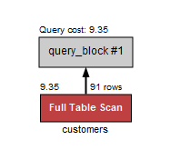
Tuning Queries
Most databases support an explain command, which allows you to see what plan is being used for a query.
The explain command also shows the statistics that the optimizer used or computed for different parts of the query plan, and estimates of the costs of each part of a query plan.

Slide 24
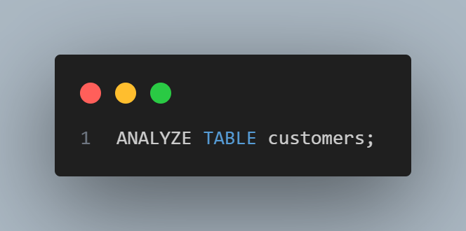
Tuning Queries
Incorrect statistics are often the reason for the choice of a bad plan
Ideally, database statistics should be updated whenever relations are updated.
Databases either periodically update statistics or leave it to the system administrator to issue a command to update statistics.
Some databases, such as MySQL support a command called analyze, which can be used to recompute statistics.

Slide 25
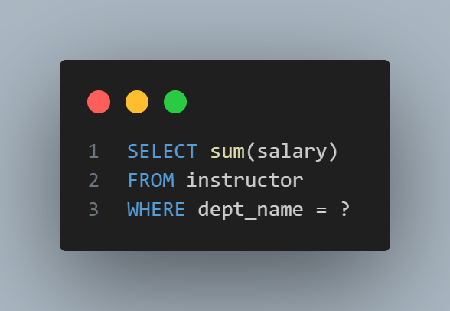
Improving SELECT Queries
Consider a program that loops through each department, invoking an embedded query to find the total salary of all instructors in the department:
If the instructor relation does not have an index on dept _name, each query will result in a scan of the relation.
Even if there is such an index, a random I/O operation will be required for each dept_name value

Slide 26

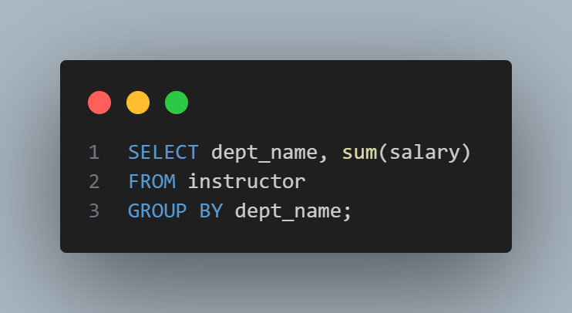

Improving SELECT Queries
Instead, we can use a single SQL query to find total salary expenses of each department
This query can be evaluated with a single scan of the instructor relation.
The results can be fetched to the client side using a single request, and the client program can then step through the results to find the aggregate for each department.
Combining multiple SQL queries into a single SQL query as above can reduce execution costs greatly in many cases, if the instructor relation is very large and has a large number of departments.

Slide 27
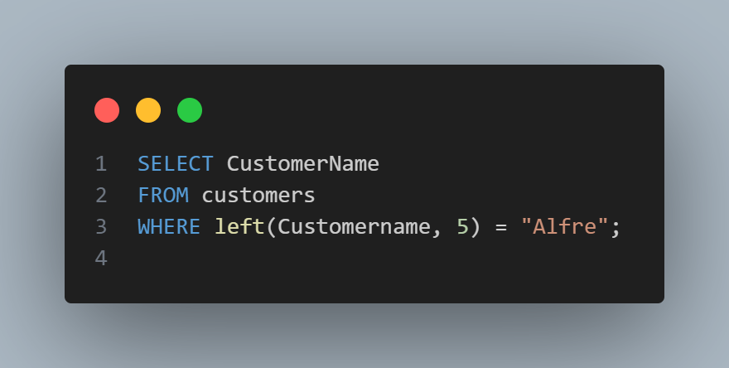
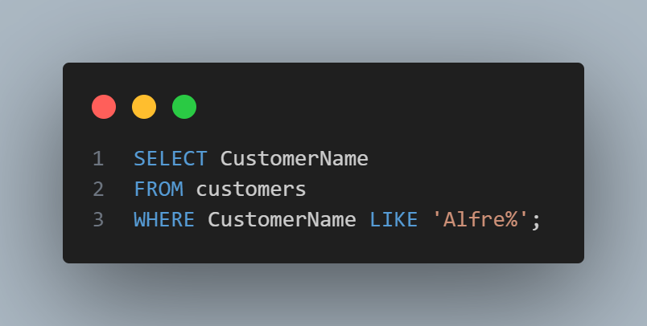
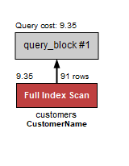
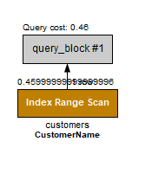
Improving SELECT Queries

Slide 28
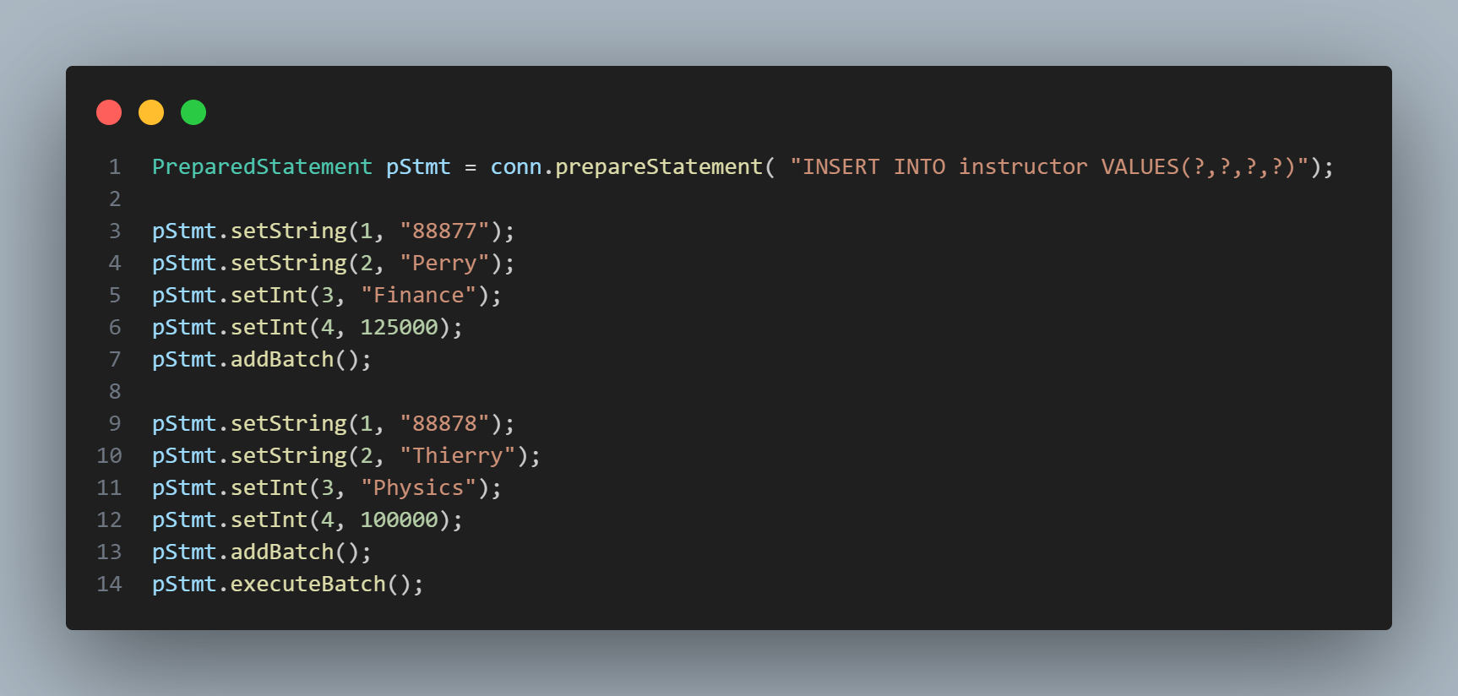
Batch Update
The JDBC API also provides a feature called batch update that allows a number of inserts to be performed using a single communication with the database.
In the absence of batch update, as many rounds of communication with the database are required as there are instructors to be inserted. The batch update feature also enables the database to process a batch of inserts at once, which can potentially be done much more efficiently than a series of single record inserts.

Slide 29
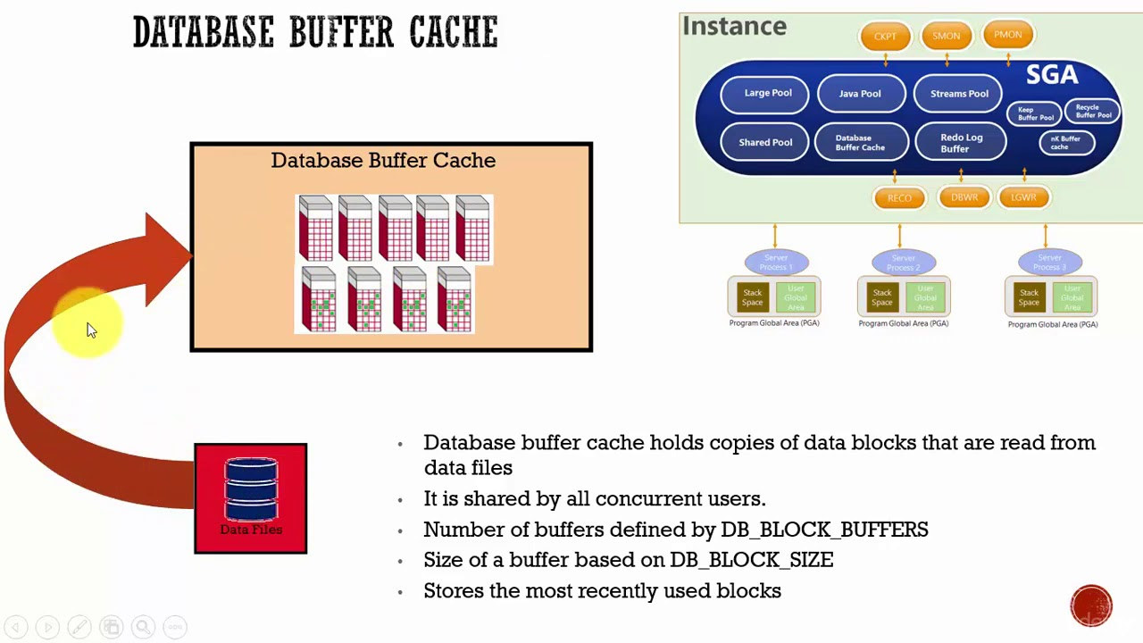
Tuning Database Parameters
The second level consists of the database-system parameters, such as buffer size and checkpointing intervals.
A buffer is a memory location used by a database management system (DBMS) to temporarily hold data that has recently been accessed or updated in the database.
This buffer acts as a link between the programs accessing the data and the physical storage devices
The database buffer is essential for enhancing the DBMS's overall performance. Caching frequently requested data in memory, it decreases the frequency of disc I/O operations, accelerating query and transaction processing.

Slide 30
Tuning Database Parameters
Most database-system manuals provide information on what database-system parameters can be adjusted, and how you should choose values for the parameters.
Well-designed database systems perform as much tuning as possible automatically, freeing the user or database administrator from the burden.
In many database systems, the buffer size is fixed but tunable.
If the system automatically adjusts the buffer size, then the database administrator will not have to worry about tuning the buffer size.

Slide 31
Tuning Hardware
The lowest level is at the hardware level.
Options for tuning systems at this level include:
Replacing hard disks with solid-state drives (which use flash storage),
Adding more disks
Using a RAID system if disk I/O is a bottleneck.
Adding more memory if the disk buffer size is a bottleneck.
Moving to a system with more processors if CPU usage is a bottleneck.

